Slide 1

A Locational Analysis for Future Commercial and Industrial Development in San Marcos, Tx
Planning for the future.

Slide 2
Central Texas Consulting Team
Philip Ramirez (Team Manager)
Paul Daugherty (Assistant Manager/GIS Analyst)
Jared Reid (Webmaster/GIS Analyst)
Jeff Ivy (GIS Analyst)

Slide 3
Project Objective
The main objective of this study was to identify at least 10 parcels of land either within or adjacent to the city limits of San Marcos that are a minimum of 15 acres, and would be most suitable for large industrial or commercial businesses to be developed in the city.

Slide 4

Literature Review
Levy, J. 2006. Contemporary Urban Planning. p. 352 New Jersey: Prentice Hall.
Middle Range Model – the process of scanning an area to understand where to look with greater detail.
Foundation for Macro and Micro Analysis

Slide 5

Literature Review
Malczewski, J. 1999. GIS and Multi criteria Decision Analysis. “Information and Decision Making” p.69 New York: John Wiley & Sons, Inc.
Foundation for Macro and Micro Analysis

Slide 6
Data
Projection: State_Plane_South_Central4204
Coordinate System:
Data can be organized into three categories:
Infrastructure
Physical Features
Boundaries

Slide 7
Infrastructure Data
Transmission Lines
Source: Joan Hickey from the city of San Marcos
LCRA (Pedernales Electric)
Bluebonnet Electric
Water Main
Source: Joan Hickey from the city of San Marcos
Waste Water Interceptors
Source: Joan Hickey from the city of San Marcos
Roads
Source: Joan Hickey from the city of San Marcos
Road Network Layer
Source: ESRI
Buildings
Source: Joan Hickey from the city of San Marcos

Slide 8
Physical Feature Data
Floodplains
Source: Joan Hickey from the city of San Marcos
DEM (Digital Elevation Model)
Source: USGS’s Seamless Server
Contours
Source: Capital Area Metropolitan Planning Organization’s (CAPCOG)
Aquifer
Source: Joan Hickey from the city of San Marcos

Slide 9
Boundary Data
City Limit
Source: Joan Hickey from the city of San Marcos
ETJ Boundary
Source: Joan Hickey from the city of San Marcos
Parcel Layer
Source: Joan Hickey from the city of San Marcos
Vacant Parcels
Source: Capital Area Metropolitan Planning Organization’s (CAPCOG)
Zoning
Source: Joan Hickey from the city of San Marcos
Future land use
Source: Joan Hickey from the city of San Marcos

Slide 10
Methodology

Slide 11
Methods: Weighted Overlay
Overlay: distance to major highways, distance to the city’s water mains, the distance from the city’s wastewater interceptors, the distance from three phase transmission lines, and the slope of the land.
Eliminated unusable land that is in the 100 year Floodplain, an occupied property, or above the Edwards Aquifer

Slide 12
Vector to Raster Conversion
Spatial Analyst tool
Defined the raster layers to 95.342 feet
Converted the DEM to slope
Vector to Raster: created binary rasters for the 100 year floodplain, the occupied property, and the Edwards Aquifer
Straight line distance: Major highways, three phase transmission lines, water mains, and wastewater interceptors.

Slide 13
Reclassifying the Layers
Reclassified the slope and the distance from the infrastructure in a 10 to 1 scale
The shortest distance from the infrastructure received a value of 10
Distance from infrastructure divided into 10 equal intervals at about half mile
The smallest slope received a value of 10
The slope of the land was divided into 10 equal intervals at about .87 percent

Slide 14
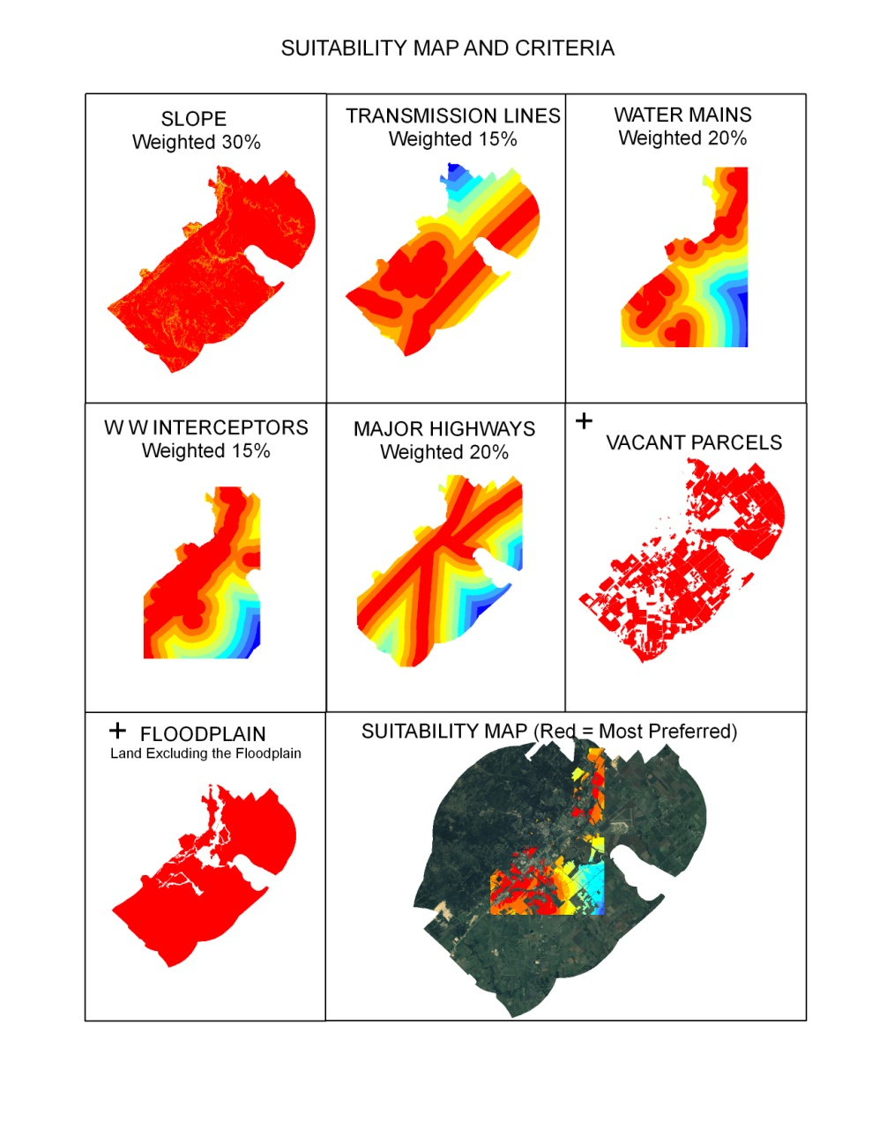
The Weighted Overlay Process

Slide 15
Results
Our results can be separated into two categories
Macro Analysis results
Micro Analysis results

Slide 16
Macro Analysis Results
The suitability map focuses on weighted distances of city infrastructure, select physical features, and vacancy classification.
Calculations were performed to show percent and acreage of suitability within each parcel.
The chart shows the percent of land deemed suitable and acres of parcel suitable from this process.

Slide 17
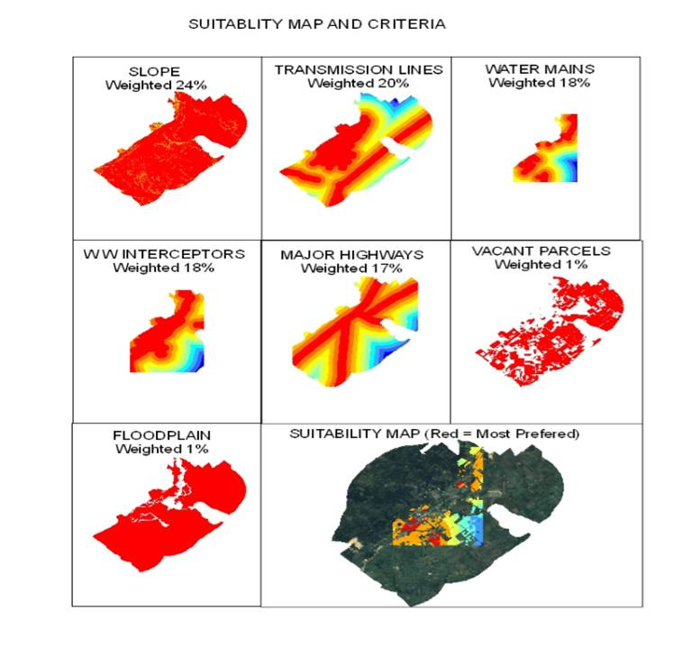
Suitability Map and Criteria

Slide 18
Macro Analysis Results
The suitability map focuses on weighted distances of city infrastructure, select physical features, and vacancy classification.
Calculations were performed to show percent and acreage of suitability within each parcel.
The chart shows the percent of land deemed suitable and acres of parcel suitable from this process.

Slide 19
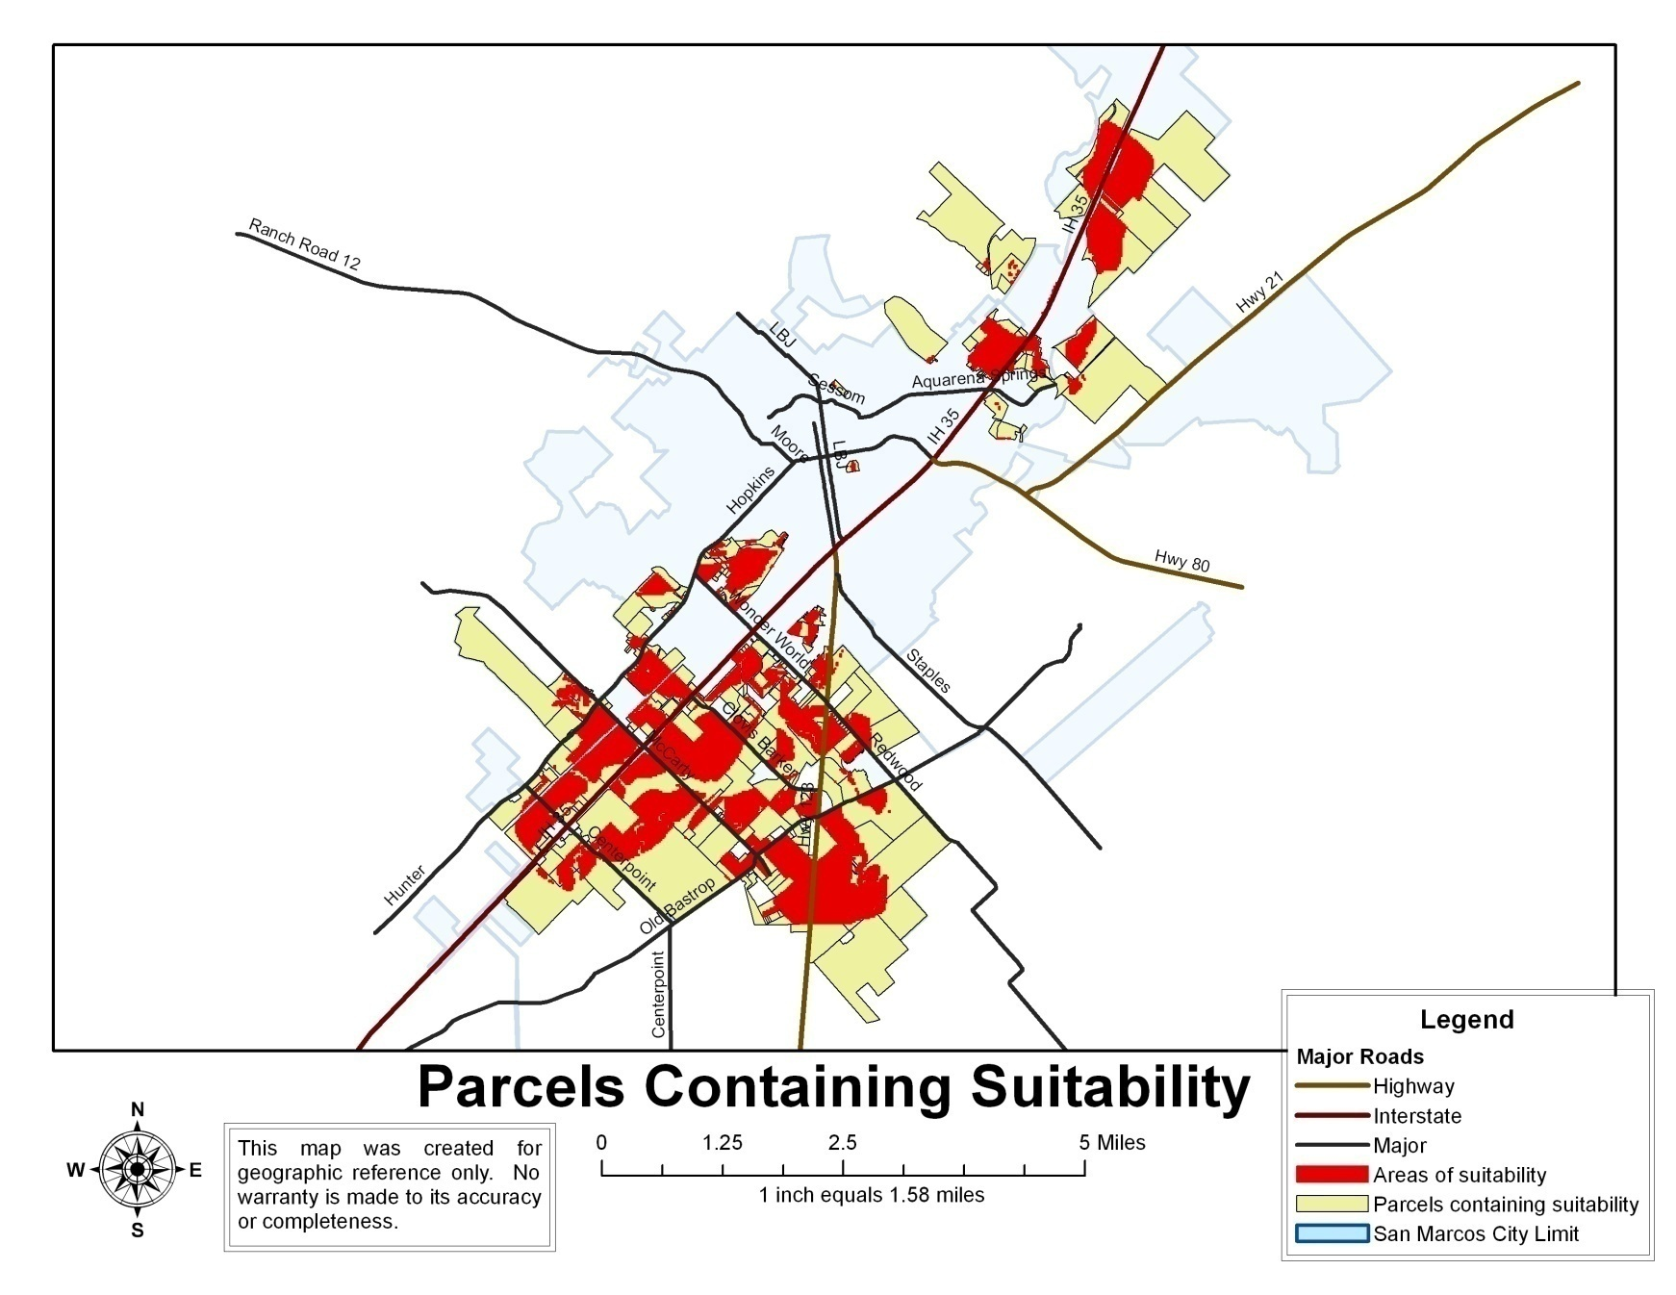
Parcels Containing Suitability

Slide 20
Macro Analysis Results
The suitability map focuses on weighted distances of city infrastructure, select physical features, and vacancy classification.
Calculations were performed to show percent and acreage of suitability within each parcel.
The chart shows the percentage of land and the number of acres deemed suitable from the selected parcels.

Slide 21
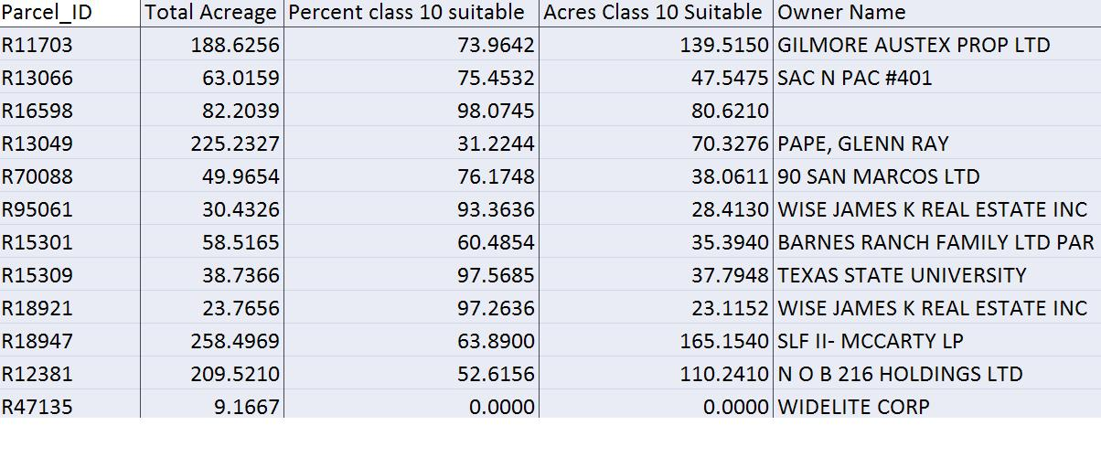
Table

Slide 22
Micro Analysis Results
The Micro Analysis report offers more detailed information about each parcel
A digital photo taken of the selected sites shows what clearing may be needed.
The results of the Micro Analysis offer supplemental information about the selected parcels of the Macro Analysis suitability findings.

Slide 23
Discussion

